Slide 1
Spring

Slide 2
Spring Core

Slide 3
Training Overview
Introduction to Spring Framework
BeanFactory and ApplicationContext
XML based configuration
Building the first Application in IntelliJ
Dependency Injection & IoC

Slide 4
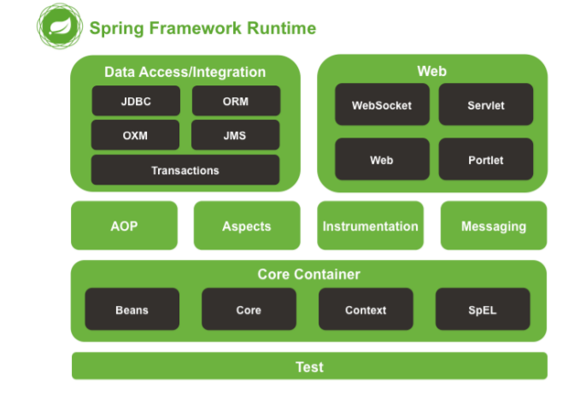
Introduction to Spring Framework
The Spring Framework is a Java platform that provides comprehensive infrastructure support for developing Java applications. Spring handles the infrastructure so you can focus on your application
It does that with the help of Dependency Injection and Inversion of Control(IoC) Framework
The Spring Framework consists of features organized into about 20 modules.

Slide 5
Introduction to Spring Framework
Core Container
Core Container consists of the spring-core, spring-beans, spring-context, springcontext-support, and spring-expression (Spring Expression Language) modules.
The spring-core and spring-beans modules provide the fundamental parts of the framework, including the IoC and Dependency Injection features.
The Context (spring-context) module builds on the solid base provided by the Core and Beans modules: it is a means to access objects in a framework-style manner that is similar to a JNDI registry.
The Context module inherits its features from the Beans module and adds support for internationalization (using, for example, resource bundles), event propagation, resource loading, and the transparent creation of contexts by, for example, a Servlet container. The Context module also supports Java EE features such as EJB, JMX, and basic remoting.
The ApplicationContext interface is the focal point of the Context module.
spring-context-support provides support for integrating common third-party libraries into a Spring application context.

Slide 6
BeanFactory & Application Context
BeanFactory interface provides the configuration framework and basic functionality
ApplicationContext interface adds more super set of BeanFactory and adds more enterprise-specific functionality
There are several implementations of ApplicationContext. Below two are used for Standalone application
ClassPathXmlApplicationContext
FileSystemXmlApplicationContext
Spring IoC container consumes a form of configuration metadata that represents how an application developer can tell Spring Container to instantiate ,configure and assemble objects in your application

Slide 7
XML based configuration sample
<?xml version="1.0" encoding="UTF-8"?>
<beans xmlns="http://www.springframework.org/schema/beans"
xmlns:xsi="http://www.w3.org/2001/XMLSchema-instance"
xsi:schemaLocation="http://www.springframework.org/schema/beans
http://www.springframework.org/schema/beans/spring-beans.xsd">
<bean id="emp" class="beans.Employee">
<property name="name" value=“Yahya"/>
<property name="role" value="Developer" />
<property name="loc" value="mumbai" />
</bean>
</beans>

Slide 8
XML based configuration sample
<?xml version="1.0" encoding="UTF-8"?>
<beans xmlns="http://www.springframework.org/schema/beans"
xmlns:xsi="http://www.w3.org/2001/XMLSchema-instance"
xsi:schemaLocation="http://www.springframework.org/schema/beans
http://www.springframework.org/schema/beans/spring-beans.xsd">
<bean id="emp" class="beans.Employee">
<property name="name" value=“Yahya"/>
<property name="role" value="Developer" />
<property name="loc" value="mumbai" />
</bean>
</beans>

Slide 9
Building the First Spring Application
import beans.Employee;
import org.springframework.context.ApplicationContext;
import org.springframework.context.support.ClassPathXmlApplicationContext;
public class App {
public static void main( String[] args )
{
System.out.println( "Hello World!" );
ApplicationContext ctx= new ClassPathXmlApplicationContext(new String[] {"bean.xml"});
Employee e = (Employee)ctx.getBean("emp");
System.out.println(e.getName());
}
}

Slide 10
Plain Old Java Object - POJO
package beans;
public class Employee {
private String name; private String role; private String loc;
public Employee()
{
System.out.println("Employee Object created");
}
public String getName() {
return name;
}
public void setName(String name) {
this.name = name;
}
public String getRole() {
return role;
}
public void setRole(String role) {
this.role = role;
}
public String getLoc() {
return loc;
}
public void setLoc(String loc) {
this.loc = loc;
}
}

Slide 11
Dependency Injection
Dependency injection (DI) is a process whereby objects define their dependencies, that is, the other objects they work with, only through constructor arguments, arguments to a factory method, or properties that are set on the object instance after it is constructed or returned from a factory method.
This process is fundamentally the inverse, hence the name Inversion of Control (IoC).
DI has two major variants
Setter based dependency injection
Constructor based dependency injection

Slide 12
Setter injection
public class SimpleMovieLister {
// the SimpleMovieLister has a dependency on the Movie Finder
private MovieFinder movieFinder;
// a setter method so that the Spring container can inject a MovieFinder
public void setMovieFinder(MovieFinder movieFinder) {
this.movieFinder = movieFinder;
}
// business logic that actually uses the injected MovieFinder is omitted...
}

Slide 13
Constructor based DI
Constructor-based DI is accomplished by container invoking a constructor with a number of arguments each representing a dependency.
Constructor argument resolution - Constructor argument resolution matching occurs using the argument’s type. If no potential ambiguity exists in the constructor arguments of a bean definition, then the order in which the constructor arguments are defined in a bean definition is the order in which those arguments are supplied to the appropriate constructor when the bean is being instantiated.
package x.y;
public class Foo
{ public Foo(Bar bar, Baz baz)
{ // ... }
}
<beans>
<bean id="foo" class="x.y.Foo">
<constructor-arg ref="bar"/>
<constructor-arg ref="baz"/>
</bean>
<bean id="bar" class="x.y.Bar"/>
<bean id="baz" class="x.y.Baz"/>
</beans>

Slide 14
Constructor Injection Demo
public class SimpleMovieLister
{
// the SimpleMovieLister has a dependency on a MovieFinder
private MovieFinder movieFinder;
// a constructor so that the Spring container can inject a MovieFinder
public SimpleMovieLister(MovieFinder movieFinder)
{
this.movieFinder = movieFinder;
}
// business logic that actually uses the injected MovieFinder is omitted...
}

Slide 15
Injecting Collections
<list/>, <set/>, <map/>, and <props/> elements, you set the properties and arguments of
the Java Collection types List, Set, Map, and Properties, respectively.
<property name="adminEmails">
<props>
<prop key="administrator">administrator@example.org</prop>
<prop key="support">support@example.org</prop>
<prop key="development">development@example.org</prop>
</props>
</property>

Slide 16
Injecting Collections
<!-- results in a setSomeList(java.util.List) call -->
<property name="someList">
<list>
<value>a list element followed by a reference</value>
<ref bean="myDataSource" />
</list>
</property>

Slide 17
Injecting Collections
<!-- results in a setSomeMap(java.util.Map) call -->
<property name="someMap">
<map>
<entry key="an entry" value="just some string"/>
<entry key ="a ref" value-ref="myDataSource"/>
</map>
</property>
<!-- results in a setSomeSet(java.util.Set) call -->
<property name="someSet">
<set>
<value>just some string</value>
<ref bean="myDataSource" />
</set>
</property>

Slide 18
Spring Annotations

Slide 19
Annotation based Container Configuration
Annotation injection is processed before XML injection.
XML should include context namespace to support context tags
<?xml version="1.0" encoding="UTF-8"?>
<beans xmlns="http://www.springframework.org/schema/beans"
xmlns:xsi="http://www.w3.org/2001/XMLSchema-instance"
xmlns:context="http://www.springframework.org/schema/context"
xsi:schemaLocation="http://www.springframework.org/schema/beans
http://www.springframework.org/schema/beans/spring-beans.xsd
http://www.springframework.org/schema/context
http://www.springframework.org/schema/context/spring-context.xsd">
<context:annotation-config/>
</beans
<context:annotation-config/> only looks for annotations on beans in the same application
context in which it is defined. This means that, if you put <context:annotation-config/

Slide 20
Annotation based Container Configuration
An alternative to XML setups is provided by annotation-based configuration which rely on the bytecode metadata for wiring
up components instead of XML
@Required
The @Required annotation applies to bean property setter methods for ensuring the value is always provided
@Autowired
You can apply the @Autowired annotation on Constructor and Setter
@Qualifier
We use @Qualifier along with @Autowired to provide the bean id or bean name we want to use in ambiguous situations.
@Bean
marks a factory method which instantiates a Spring bean:
Life Cycle Annotation
@PostConstruct
@PreDestroy

Slide 21
Java-based Container Configuration
@Configuration – indicates that its primary purpose is as a source of bean definitions. Furthermore, @Configuration classes allow inter-bean dependencies to be defined by simply calling other @Bean methods in the same class. The simplest possible @Configuration class would read as follows:
@Bean – this annotation is used to indicate the a method instantiates, configure and and initializes a new object to be managed by the Spring IoC container.
It is the same as <bean> tag in beans.xml
Example
@Configuration
public class AppConfig
{
@Bean
public MyService myService()
{ return new MyServiceImpl();
}
}
public static void main(String[] args)
{ ApplicationContext ctx = new AnnotationConfigApplicationContext(AppConfig.class);
MyService myService = ctx.getBean(MyService.class);
myService.doStuff(); }

Slide 22
Injecting Collections
<!-- results in a setSomeMap(java.util.Map) call -->
<property name="someMap">
<map>
<entry key="an entry" value="just some string"/>
<entry key ="a ref" value-ref="myDataSource"/>
</map>
</property>
<!-- results in a setSomeSet(java.util.Set) call -->
<property name="someSet">
<set>
<value>just some string</value>
<ref bean="myDataSource" />
</set>
</property>

Slide 23
Aspect Oriented Programming

Slide 24
Aspect Oriented Programming
Aspect-oriented programming is often defined as a programming technique that promotes separation of concerns within a software system.

Slide 25
Some AOP Terms
Aspect
An aspect is the cross-cutting functionality you are implementing.
Joinpoint
A joinpoint is a point in the execution of the application where an aspect can be plugged in.

Slide 26
Some AOP Terms
Advice
Advice is the actual implementation of our aspect. It is advising your application of new behavior.
Pointcut
A pointcut defines at what joinpoints advice should be applied. Advice can be applied at any joinpoint supported by the AOP framework.

Slide 27
Some AOP terms
Target
A target is the class that is being advised.
Proxy
A proxy is the object created after applying advice to the target object

Slide 28
Spring AOP Implementation

Slide 29
AOP Configuration
<?xml version="1.0" encoding="UTF-8"?> <beans xmlns="http://www.springframework.org/schema/beans" xmlns:xsi="http://www.w3.org/2001/XMLSchema-instance" xmlns:aop="http://www.springframework.org/schema/aop" xsi:schemaLocation=" http://www.springframework.org/schema/beans http://www.springframework.org/schema/beans/spring-beans.xsd http://www.springframework.org/schema/aop http://www.springframework.org/schema/aop/spring-aop.xsd"> <aop:config> <aop:aspect id = "log" ref = "logging"> <aop:pointcut id = "selectAll" expression = "execution(* org.example.*.*(..))"/> <aop:before pointcut-ref = "selectAll" method = "beforeAdvice"/> <aop:after pointcut-ref = "selectAll" method = "afterAdvice"/> <aop:after-returning pointcut-ref = "selectAll" returning = "retVal" method = "afterReturningAdvice"/> <aop:after-throwing pointcut-ref = "selectAll" throwing = "ex" method = "AfterThrowingAdvice"/> </aop:aspect> </aop:config> <!-- Definition for student bean --> <bean id = "student" class = "org.example.Student"> <property name = "name" value = "Zara" /> <property name = "age" value = "11"/> </bean> <!-- Definition for logging aspect --> <bean id = "logging" class = "org.example.Logging"/> </beans>

Slide 30
Example Advice
package org.example; public class Logging { /** * This is the method which I would like to execute * before a selected method execution. */ public void beforeAdvice(){ System.out.println("Going to setup student profile."); } /** * This is the method which I would like to execute * after a selected method execution. */ public void afterAdvice(){ System.out.println("Student profile has been setup."); } /** * This is the method which I would like to execute * when any method returns. */ public void afterReturningAdvice(Object retVal) { System.out.println("Returning:" + retVal.toString() ); } /** * This is the method which I would like to execute * if there is an exception raised. */ public void AfterThrowingAdvice(IllegalArgumentException ex){ System.out.println("There has been an exception: " + ex.toString()); } }

Slide 31
Example Target
package org.example; public class Student{ private Integer age; private String name; public void setAge(Integer age) { this.age = age; } public Integer getAge() { System.out.println("Age : " + age ); return age; } public void setName(String name) { this.name = name; } public String getName() { System.out.println("Name : " + name ); return name; } public void printThrowException(){ System.out.println("Exception raised"); throw new IllegalArgumentException(); } }

Slide 32
Example
package org.example; import org.springframework.context.ApplicationContext; import org.springframework.context.support.ClassPathXmlApplicationContext; /** * Hello world! * */ public class App { public static void main( String[] args ) { System.out.println( "Hello World!" ); ApplicationContext context = new ClassPathXmlApplicationContext("beans.xml"); Student student = (Student) context.getBean("student"); student.getName(); student.getAge(); student.printThrowException(); } }

Slide 33
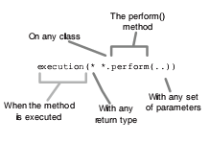
Pointcut Expressions in AspectJ

Slide 34
Implementing Spring
Spring and JDBC
JdbcTemplate

Slide 35
Managing Transaction

Slide 36
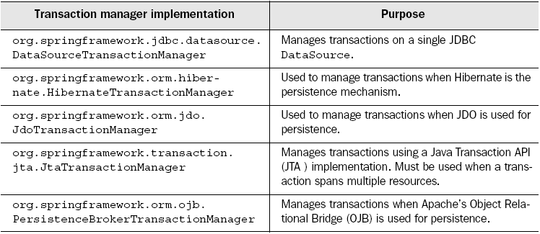
Transaction Managers

Slide 37
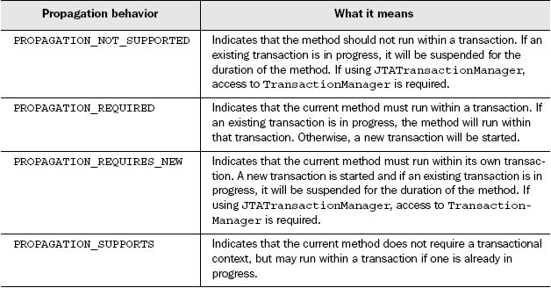
Propagation Attributes

Slide 38
Isolation Levels

Slide 39
Propagations Attributes

Slide 40
Transaction Attributes
NameMatchTransactionAttributeSource
MatchAlwaysTransactionAttributeSource
DefaultTransactionAttribute

Slide 41
Spring MVC

Slide 42
Spring and MVC
Spring's MVC package provides a Model-View-Controller (MVC) implementation for web applications
Spring's MVC framework is not just any old implementation; it provides a clean separation between domain model code and web forms, and allows you to use all the other features of the Spring Framework.

Slide 43
Spring and MVC

Slide 44
Request Life-cycle
DispatchServlet receives a HTTP request
DispatchServlet selects a Controller based on the URL Handler mapping and pass the request to the Controller
Controller performs the business logic (and set values of Model objects)
Controller returns ModelAndView object
ViewResolver selects a view
A selected view gets displayed (using values of Model objects)

Slide 45
Spring-servlet.xml
<?xml version="1.0" encoding="UTF-8"?>
<beans xmlns="http://www.springframework.org/schema/beans"
xmlns:xsi="http://www.w3.org/2001/XMLSchema-instance"
xmlns:context="http://www.springframework.org/schema/context"
xmlns:mvc="http://www.springframework.org/schema/mvc"
xsi:schemaLocation="
http://www.springframework.org/schema/beans
http://www.springframework.org/schema/beans/spring-beans.xsd
http://www.springframework.org/schema/context
http://www.springframework.org/schema/context/spring-context.xsd
http://www.springframework.org/schema/mvc
http://www.springframework.org/schema/mvc/spring-mvc.xsd">
<!--Provide support for conversion, formatting and validation -->
<mvc:annotation-driven/>
</beans>

Slide 46
View Resolvers
View Resolver maps view names to actual views.
InternalResourceViewResolver
BeanNameViewResolver etc
<bean id="viewResolver" class="org.springframework.web.servlet.view.InternalResourceViewResolver">
<property name="prefix" value="/WEB-INF/jsp/"></property>
<property name="suffix" value=".jsp"></property>
</bean>

Slide 47
Reading Request Parameters
You can pass on the HttpServletRequest Object into the controller methods OR
You can read @RequestParam to have the spring container read the values

Slide 48
Model Interface
In Spring MVC, the model contains the data of the application. Here, a data can be in any form such as objects, strings, information from the database, etc.
The object of HttpServletRequest reads the information provided by the user and pass it to the Model interface.
Model Interface Methods
Model addAllAttributes(Collection<?> arg) | It adds all the attributes in the provided Collection into this Map.
Model addAllAttributes(Map<String,?> arg) | It adds all the attributes in the provided Map into this Map.
Model addAllAttribute(Object arg) | It adds the provided attribute to this Map using a generated name.
Model addAllAttribute(String arg0, Object arg1) | It binds the attribute with the provided name.
Map<String, Object> asMap() | It return the current set of model attributes as a Map.
Model mergeAttributes(Map< String,?> arg) | It adds all attributes in the provided Map into this Map, with existing objects of the same name taking precedence.
boolean containsAttribute(String arg) | It indicates whether this model contains an attribute of the given name

Slide 49
MVC Tag libraries
The Spring MVC form tags are the configurable and reusable building blocks for a web page. These tags provide JSP, an easy way to develop, read and maintain.
The Spring MVC form tags can be seen as data binding-aware tags that can automatically set data to Java object/bean and also retrieve from it. Here, each tag provides support for the set of attributes of its corresponding HTML tag counterpart, making the tags familiar and easy to use.
Below tag library can be used for MVC tags
<%@ taglib prefix="form" uri="http://www.springframework.org/tags/form" %>
Use the type attribute for getting more specific controls against the input type.
<form:input type=“date” path="date" />
Form tags
Form:form | It is a container tag that contains all other form tags.
form:input | This tag is used to generate the text field.
form:radiobutton | This tag is used to generate the radio buttons.
form:checkbox | This tag is used to generate the checkboxes.
form:password | This tag is used to generate the password input field.
form:select | This tag is used to generate the drop-down list.
form:textarea | This tag is used to generate the multi-line text field.

Slide 50
Event Handling
Spring Application Context
Runtime
Spring Application Event
Object
Application Event Listener
Event Handler

